Slide 1
Complete the table
10 minutes
Quote | Language technique | Effect
Duncan: (about Macbeth) “I have begun to plant thee, and will labour/ To make thee full of growing.” | metaphor | Metaphor people as trees
Macbeth: “Is this a dagger which I see before me?” | Question
Lady Macbeth: (to Macbeth) “My hands are of your colour; but I shame/To wear a heart so white.” | Turning
Macduff: “Not in the legions/Of horrid Hell can come a devil more damned/In evils to top Macbeth.”

Slide 2
Let’s start with some basic analysis and comprehension of an extract.
Explore the phrase ‘withered and wild’ – what does it reveal about the witches?
This first reveals that the witches are not having a good appearance, and they might be wild also because of the strange things that they said to Macbeth and Banquo. The word “withered” also states that the witches don’t have a good appearance from another way.
This is from the moment Macbeth and Banquo meet the witches...
MACBETH
So foul and fair a day I have not seen.
BANQUO
How far is't call'd to Forres? What are these So wither'd and so wild in their attire, That look not like the inhabitants o' the earth, And yet are on't? Live you? or are you aught That man may question? You seem to understand me, By each at once her chappy finger laying Upon her skinny lips: you should be women, And yet your beards forbid me to interpret That you are so.
MACBETH
Speak, if you can: what are you?
First Witch
All hail, Macbeth! hail to thee, thane of Glamis!
Second Witch
All hail, Macbeth, hail to thee, thane of Cawdor!
Third Witch
All hail, Macbeth, thou shalt be king hereafter!
BANQUO
Good sir, why do you start; and seem to fear Things that do sound so fair? I' the name of truth, Are ye fantastical, or that indeed Which outwardly ye show?
What are their reactions to seeing the witches there in front of them? How do they react?
They are surprised and felt wired
Macbeth is more interested in these witches than Banquo;
Banquo
What does the use of repetition
bring to this scene?
The repetition made the audience felt that the things witches said is very critical, at least from the witches perspective,

Slide 3
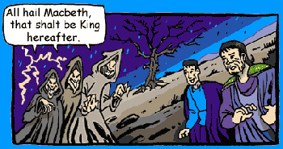
More close analysis...
How can you tell Macbeth is confused and frustrated?
Make rough notes here and highlight the specific quotations that suggest this.
“imperfect speakers” shows that Macbeth
MACBETH
Stay, you imperfect speakers, tell me more: By Sinel's death I know I am thane of Glamis; But how of Cawdor? the thane of Cawdor lives, A prosperous gentleman; and to be king Stands not within the prospect of belief, No more than to be Cawdor. Say from whence You owe this strange intelligence? or why Upon this blasted heath you stop our way With such prophetic greeting? Speak, I charge you.
Witches vanish
List 3 of the best power words for analysis in this extract.
How can we tell from this extract that Macbeth is used to having authority and being in power?

Slide 4
CLOSE ANALYSIS
Banquo warns Macbeth that the witches may mean him harm...
“MACBETH
To BANQUO
Do you not hope your children shall be kings, When those that gave the thane of Cawdor to me Promised no less to them?
BANQUO
That trusted home Might yet enkindle you unto the crown, Besides the thane of Cawdor. But 'tis strange: And oftentimes, to win us to our harm, The instruments of darkness tell us truths, Win us with honest trifles, to betray's In deepest consequence.
The word ‘hope’ implies…

Slide 5
Essay question
Task: Create an essay question based on this extract.
What would Edexcel be likely to ask you? What are they looking for?
Hint: have a look at the Literature exam guide on Moodle…

Slide 6
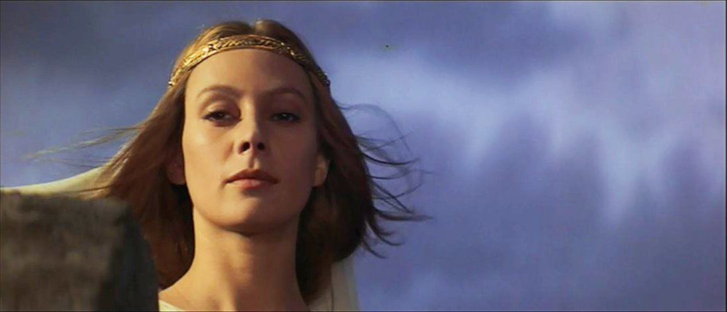
Analyse these specific quotations spoken by Lady Macbeth thinking about her husband’s new future...
Ghost, the spirits states that there is something supernatural events happening
Come, you spirits That tend on mortal thoughts, unsex me here,
aggressive
“make thick my blood; Stop up the access and passage to remorse
Come, thick night, And pall thee in the dunnest smoke of hell,
Only look up clear; To alter favour ever is to fear: Leave all the rest to me.

Slide 7
LENNOX
Goes the king hence to-day?
MACBETH
He does: he did appoint so.
LENNOX
The night has been unruly: where we lay, Our chimneys were blown down; and, as they say, Lamentings heard i' the air; strange screams of death, And prophesying with accents terrible Of dire combustion and confused events New hatch'd to the woeful time: the obscure bird Clamour'd the livelong night: some say, the earth Was feverous and did shake.
MACBETH
'Twas a rough night.
LENNOX
My young remembrance cannot parallel A fellow to it.
Re-enter MACDUFF
MACDUFF
O horror, horror, horror! Tongue nor heart Cannot conceive nor name thee!
MACBETH LENNOX
What's the matter.
Just before Duncan’s body is discovered...
Quotation | Deeper meanings/ effects of line/ quotation | Context link
The night has been unruly: where we lay
Of dire combustion and confused events
Lamentings heard i' the air; strange screams of death,
O horror, horror, horror!

